Slide 1

PARKING REQUEST MANAGEMENT

Slide 2
Contents
Objective
Functional Specifications
Technical Specifications

Slide 3
OBJECTIVE
Create an API endpoint to be used to register a parking right

Slide 4
FUNCTIONAL SPECIFICATIONS
Request :
A parking right request should include license plate, Parking Zone Id, start date time, end date time, amount, and user profile ( visitor/resident).
Response:
The response to this endpoint will indicate whether or not the registration of the parking right was successful. In case of success, it will include a parking right Id.

Slide 5
TECHNICAL SPECIFICATIONS
Entity Framework core
Dependency injection
Dot net core
ILogger
Unit Test Nunit, In-Memory approach

Slide 6
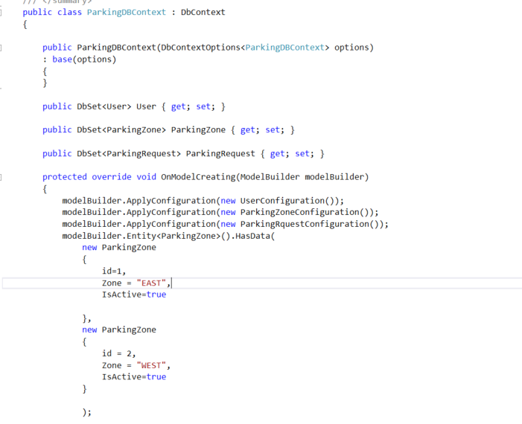
Entity Framework
Created users, parking zone and parking request tables using entity framework core code first approach
Implemented database schema using Fluent API approach

Slide 7
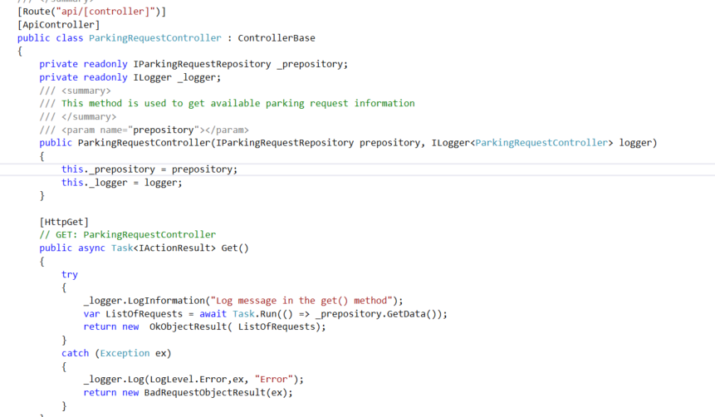
Dependency injection
Implemented Constructor level dependency injection for IParkingRequestRepository and ParkingRequestRepository, Injected the dependency at Startup.cs

Slide 8
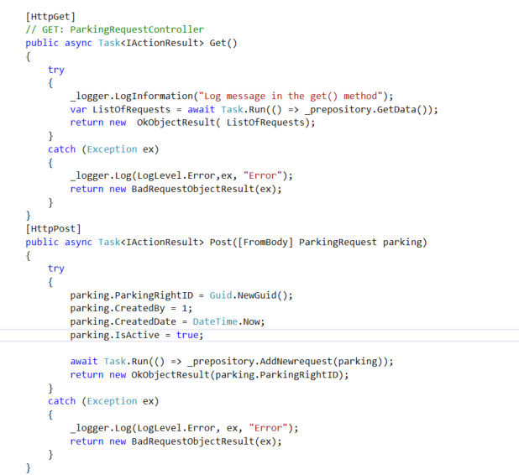
Dot net core
Created API controller using dot net core has get and put Action methods.
Action methods inside controller are asynchronous
Get method is used to get the all-existing parking request information
Post method is used to add new request and return GUID if success

Slide 9
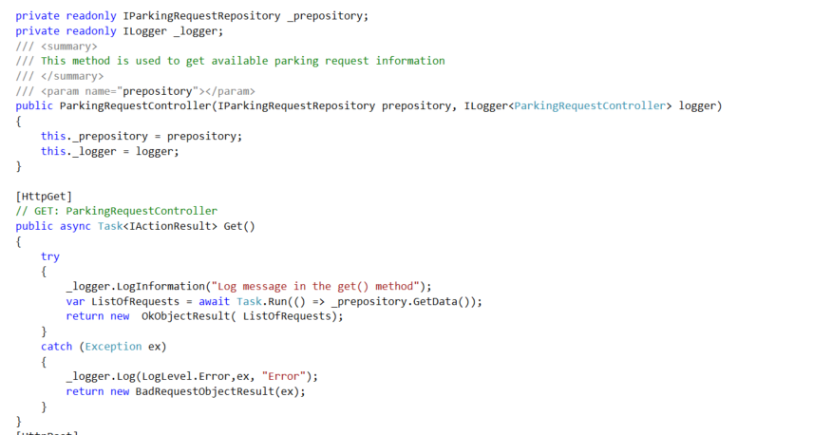
Ilogger
Implemented ILogger to log the audits and exceptions.
This will create a file on daily basis inside project logs folder

Slide 10
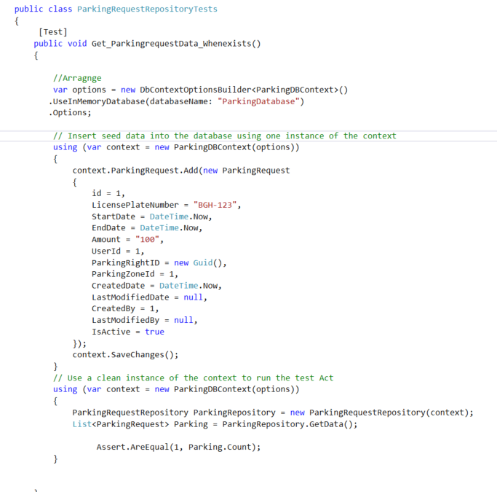
Unit Test
Created Unit test library using Nunit
Implemented in-memory approach to created a fake DBContext

Slide 11
QUESTIONS ?

Slide 12
THANK YOU

